Slide 1
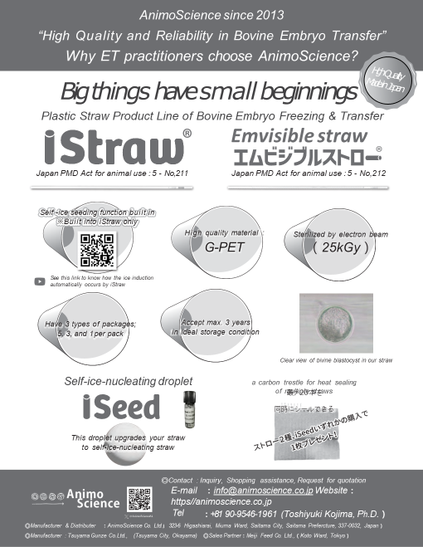
”たかがストロー、されどストロー”
技術資料集
Issue 4: 2023/11/4
※本冊子では、「胚」と「受精卵」の表記が混在していますが、同じ意味で使用していることをご了解ください．

Slide 2

《Table of Contents》
Advertising Catalogue 1
Table of Contents 2
Cooperative Framework of Manufacture 3
The Persistence of Our Products 4
The Product Range of AnimoScience 5
Specification of iStraw® 6
Effect of Co-culture with iSeed on
in vitro Development of Bovine IVP Embryos 7, 8
The Video of Ice Formation by iStraw® 9
Recommended Holding Temp. for iStraw® 10
How to Use iStraw® for Slow-Freezing of
Bovine Embryos 11
Experiment of Ice Formation Germinated
from iStraw® by an Independent Laboratory 12
Result of Transfer of Embryos Frozen
Using iStraw® 13
Quality Control of iStraw® 14
Validation of Electron Beam Sterilization 15
Comparison of Microscopy images of
G-PET straws 16
Application of iSeed 17 – 19
Order Placement 20

Slide 3
Cooperative Framework of Manufacture
◎R&D, Manufacturer and Distributer
AnimoScience、Ltd.
323-6 Higashiarai, Minuma Ward, Saitama City, Saitama 337-0032, Japan
◎Manufacturer
GUNZE Ltd.
2200 Ninomiya, Tsuyama City, Okayama 708-0013, Japan
◎Sterilization & Validation
SHI-ATEX Co., Ltd.
4-16 Midorigahara, Tsukuba City, Ibaraki 300-2646, Japan
◎Sales Partner
MEIJI FEED Co., Ltd.
1-2-10 Shinsuna, Koto Ward, Tokyo 136-0075, Japan

Slide 4
”It’s just only a straw as a container of embryo,
but it’s still considered important to ET practitioners.”
Considering the course of transfer of embryos recovered from a donor cow or in-vitro produced embryos, frozen in liquid nitrogen, the embryo’s residence time in straws is quite relatively longer than for other equipment for embryo recovery, manipulation and culture. From this viewpoint, we stick to the following seven issues of concerns:
No. 1：Reliable Sterilization（the validated electron beam sterilization and the ensured seal strength of package)
No. 2：Qualified Materials（Glycol-modified polyethylene terephthalate）
No. 3：High Transparency（the morphology of embryo aspirated into the straw can be clearly checked in situ.）
No. 4：Serviceable Packaging (four kinds of individual package; 1, 3, 5 and 10 straws)
No. 5：Made in Japan（Outstanding technology & High quality control, Stable supply, Stable price）
No. 6 : Direct Sales from the Manufacturer (Improvement of the products derived from customer’s feedback)
No. 7：Self Ice-Seeding Function（iStraw® is the world’s first successful self-ice seeding built-in straw. It can avoid human error of manual ice-seeding. Simultaneous ice-seeding of a number of straws is possible. Natural ice formation may be friendly to embryos.）

Slide 5
The product range supplied by AnimoScience
since 2023
iStraw®【Japan PMD Act for animal use No.5-211】：0.25 ml plastic straw for freezing, sterilized by electron ion beam (25 kGy) and built in the function of self-ice seeding（see pages 8 & 11 to 16 ）
Emvisible Straw®【Japan PMD Act for animal use No.5-212】：0.25 ml plastic straw for transfer and freezing of bovine embryos, sterilized by electron ion beam (25 kGy) .
③ iSeed：Sterilized (121℃, 20 min) silver iodide alginate droplet for self ice formation for bovine embryo freezing （available for every manufacturer’s 0.25ml plastic straw; see pages 19, 20)
※iSeed contains 20 droplets immersed in autoclaved distilled water in heat resistant glass bottle. iSeed can be repeatedly autoclaved （see pages 19, 20）．
Please contact us to obtain more detailed information :
info@animoscience.co.jp
https://animoscience.co.jp “Inquiry”
”Big things have Small beginnings.”

Slide 6
iStraw®
“Sterilized 0.25ml plastic straw built in self-ice seeding function for embryo freezing”
Specification:
Features: No need to conduct ice seeding manually as such straws placed in programmable freezer start to germinate ice naturally and simultaneously at optimal seeding temperature (recommendable seeding temperature is -7℃). Time saving, practitioner’s Stress relief and Risk avoidance involving manual ice seeding.
Materials of straw: Glycol-modified Polyethylene Terephthalate (PET-G)
Other materials: Sodium Alginate, braided nylon thread, silver iodide as ice nuclei
Sterilization: electron beam sterilization with 25kGy
Packing materials: PET12μm/dry laminate/LLDPE (linear low density polyethylene) 40μm
Storage conditions: Keep in cool and dry place avoiding direct sunlight and UV.
Optional Packaging: one piece/ three pieces/ five pieces and ten pieces of straws
Shelf Life: 3 years
Usage Instruction:
Straw should be placed at -7℃ to induce self-ice seeding. Typically ice germinates within less 2 min after placing it at -7℃. In case of adopting higher temperature than -7℃ for ice-seeding, 0.1 to 0.3 M sucrose solution should be placed in contact with the inner cotton plug.
Secureness: An independent study showed that bovine one cell embryos after in-vitro fertilization developed to expanded to hatched blastocysts when co-cultured with silver iodide coated by calcium alginate. There was no significant difference in the development rates between the co-culture group and the control without co-culture. In addition, we are performing the continuous transfer trial using bovine embryos frozen with iStraw. We currently observed no significant differences between the pregnancy rates using iStraw and using ordinary straw with manual ice seeding (see pages 9, 10 and 15)

Slide 7
Effect of co-culture with iSeed
on in-vitro development of bovine IVP embryos
Table 1．Result of co-culture with iSeed -1
 | cleaved/cultured
 | positive | negative | % | total
control | 85 | 24 | 78.0 | 109
Co-culture | 96 | 23 | 80.7 | 119
total | 181 | 47 |  | 228
No difference was observed（P=0.6159）.
Table 2．Result of co-culture with iSeed-2
 | developed/cultured
 | positive | negative | % | total
control | 33 | 76 | 30.3 | 109
Co-culture | 43 | 76 | 36.1 | 119
total | 76 | 152 |  | 228
No difference was observed（P=0.34851）.
Table 3．Result of co-culture with iSeed-3
 | developed/cleaved
 | positive | negative | % | total
control | 33 | 52 | 38.8 | 85
Co-culture | 43 | 53 | 44.8 | 96
total | 76 | 105 |  | 181
No difference was observed（P=0.41683）.
Please see next page!

Slide 8
．
Effect of co-culture with iSeed
on in-vitro development of bovine IVP embryos
Table 4．Result of co-culture with iSeed-4
 | hatched/blastocysts
 | positive | negative | % | total
control | 14 | 19 | 42.4 | 33
Co-culture | 27 | 16 | 62.8 | 43
total | 41 | 35 |  | 76
No difference was observed（P=0.34851）.
Table 5．Result of co-culture with iSeed-5
 | hatched/cultured
 | positive | negative | % | total
control | 33 | 76 | 30.3 | 109
Co-culture | 43 | 76 | 36.1 | 119
total | 76 | 152 |  | 228
No difference was observed（P=0.07747）.
We conclude that ice nuclei for self-seeding
does not have any detrimental effect on
development of bovine in-vitro produced embryos.

Slide 9


The video of ice formation by iStraw®
https://www.youtube.com/watch?v=6lODveB-upM&t=11s

Slide 10
Recommended Holding Temperature for iStraw®
試験実施日：2022年6月16日10:00～12:30 坂口、小島 ET-1
iStraw 植氷保持温度と氷晶形成率の関係
保持温度 | 1 | 2 | 3 | 4 | 5 | 6 | 7 | 8 | 9 | 10 | 氷晶形成率 | 氷晶の長さ（5分間）
－５℃ | － | － | － | － | － | － | － | － | － | － | 0%
－5.5℃ | － | － | － | － | ± | － | － | － | － | － | 0%
－6℃ | ± | ± | ± | ± | ± | ± | ± | ± | ± | ＋ | 10% | 10mm
－6.2℃ | ＋ | ＋ | ± | ± | ＋ | ＋ | ＋ | ＋ | ± | ＋ | 70% | 15mm
－6.5℃ | ＋ | ＋ | ＋ | ＋ | ＋ | ＋ | ＋ | ＋ | ＋ | ＋ | 100% | 20mm | 植氷温度として設定可能
－6.8℃ | ＋ | ＋ | ＋ | ＋ | ＋ | ＋ | ＋ | ＋ | ＋ | ＋ | 100% | 30mm | 植氷温度として設定可能
－7℃ | ＋ | ＋ | ＋ | ＋ | ＋ | ＋ | ＋ | ＋ | ＋ | ＋ | 100% |  | 推奨植氷温度
本試験実施の動機は、高めに植氷温度を設定する技術者がいるのでその限界を知るため．
評価基準：
当該温度のアルコール槽中に浸漬して2分以内に氷晶形成が始まったｽﾄﾛｰを＋、
2分以上5分以内に始まったｽﾄﾛｰを±、5分以内に氷晶形成がなかったものを－とした．
移植用に試作した230本のストローのうちの70本を使用した．
使用した凍結保存液は、5%EG、6%PG、0.1Mｽｸﾛｰｽ in ｴﾑﾌﾞﾘｵﾃｯｸ（A+B）＋20%CS
※綿栓部以外からの氷晶形成はみられなかった．
《Explanation of the above table》：
The ice nucleating material of iStraw and iSeed has
a potential of ice germination at -6.8℃ to -7℃
in any freezing solution containing around 1.5 M
cryoprotectant for slow-freezing of bovine embryos．
iStraw is completely compatible with any model of
programmable freezer for slow freezing of embryos.

Slide 11


How to use iStraw® for slow-freezing of bovine embryos
Please keep at -6.8～‐7℃ to accomplish the self-seeding function of iStraw®.
Any type of programmable freezer is compatible for iStraw®.
※The length of each air bubble is recommended to be 3 mm。
氷
The color of outside cotton plug is blue.
ice
air
air
Heat seal
氷晶
embryo
ice
air
air
air
Heat seal
embryo
Ice germinates from inside the cotton plug within
2 min after immersing/placing of iStraw® at -7℃.

Slide 12
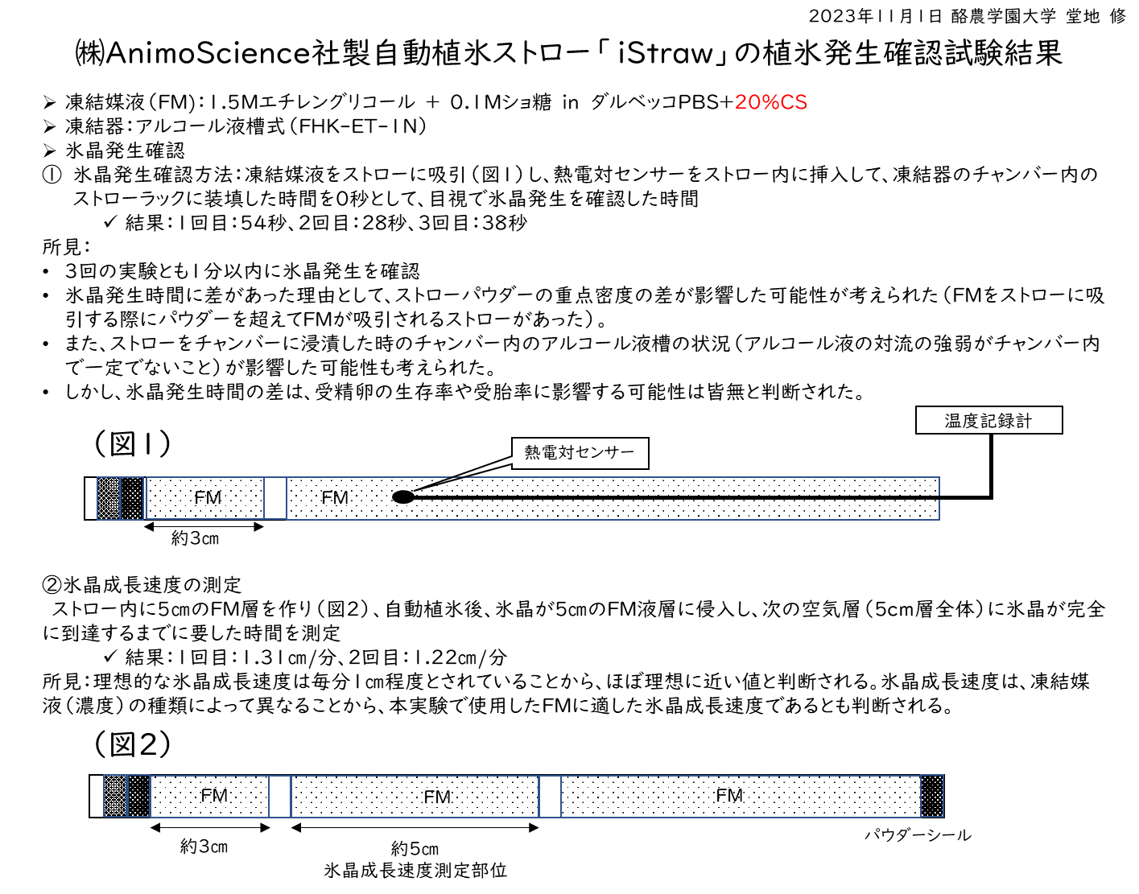
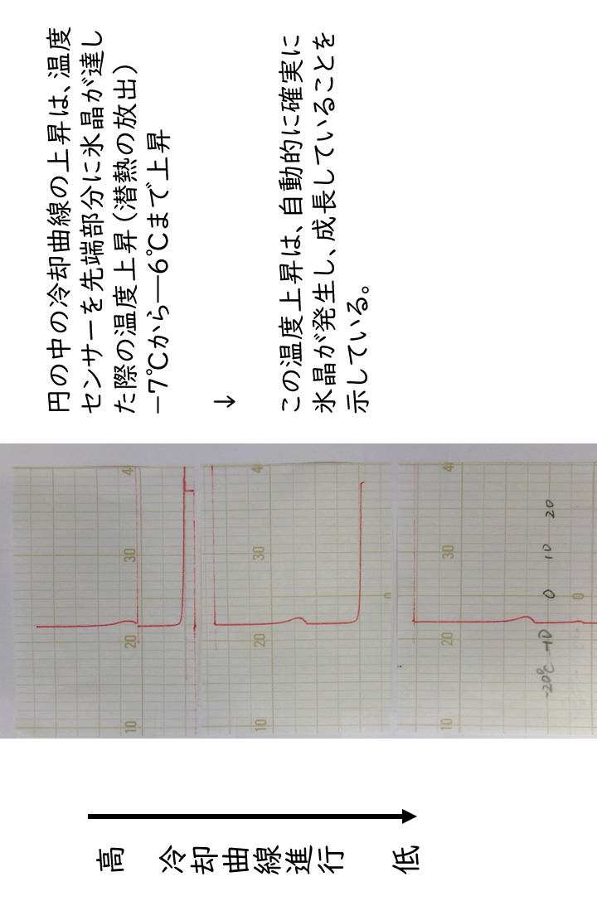
Experiment on Ice formation germinated from iStraw
by an Independent laboratory
Prof. Dr. Osamu Dochi, Rakuno University, Japan
【Materials and Methods】
Freezing Medium (FM): 1.5 M EG, 0.1 M sucrose in modified PBS +20%CS
Programmable freezer: ET-1N (FHK, Japan)
Straw: 3 pieces of iStraw®
Method of confirmation of ice formation: The ice formation was done by
visual judgment and also temperature change was recorded using a
thermocouple sensor shown in the figure 1.
Figure 1
Thermocouple sensor
Temp. recorder
3 cm
《Measurement of the speed of ice growth》
The FM was aspirated in the manner shown in figure 2. Then ice growth from
the inside cotton plug was visually observed and time recorded until
the ice completely grew over the second column of FM.
Figure 2
Second column
3 cm
5 cm
sealed
《Results》
・The appearance time of ice germination was 54 secs, 28 sec. and 38 sec.
after immersing in alcohol bath kept at -7℃.
・The speed until the ice completely grew over the second column was
1.31 cm/min and 1.22 cm/min. These speeds of ice growth are ideal
for ice inoculation of bovine embryo freezing.
The temperature inside the straw increased from -7℃ to -6℃
when ice reached the head of the sensor (see figure 1). The latent
heat was around 1℃.
TTemperature - change curves in the hree trials

Slide 13
Table 6. Result of Transfer of Embryo frozen using iStraw
- the continuing project -
 | Embryo frozen and transferred | Became pregnant | Pregnacy rate（％）
iStraw | 50 | 21 | 42.0
Conventional straw | 54 | 24 | 44.4
No difference was observed between the two groups.
・In iStraw® group、iStraw was immersed in a -7℃ alcohol bath of programmable freezer. After confirming that the ice had automatically germinated from inside cotton plug and the ice reached over the column of embryo, the slow cooling was continued to -30℃ and then plunged into liquid nitrogen.
・In the conventional straw group, manual ice inoculation was performed at -7℃ after 1 min of immersing straw in the alcohol bath. After confirming the ice reached over the column of embryo, the slow cooling was continued to -30℃ and then plunged into liquid nitrogen.
・Freezing medium consists of 1.5M（8.3%）ethylene glycol＋0.1M sucrose＋20% calf serum（based medium：Dulbecco’s PBS；Gibco14040-133, glucose 1mg/ml、Sodium pyruvate 36μg、albumin 0.4%＋antibiotics）
・This comparison trial of transfer of embryos frozen using iStraw is our continuing project.

Slide 14
【Quality Control of iStraw®】
Test for eluted substances is obligated for the manufacturer of plastic straw for bovine embryos by the standard for Japan medical device nomenclature, animal use.
Results：
（Oct. 2, 2022 by SHI-ATEX Co., Ltd. Tsukuba center）
Sample：iStraw®
a）Appearance & pH ･･･adapted
b）Heavy metals･･･adapted
c）Potassium permanganate reducing substances･･･ adapted
d）Residue on evaporation･･･adapted
Adapted in all categories！

Slide 15
Validation of
Electron Beam Sterilization
To ensure sterility is guaranteed at 10⁻⁶（less than 1 a million products）, the products should be sterilized under the condition scientifically validated and determined. From the beginning, we focused on electron beam sterilization, not on EO gas sterilization due to concerns about residual gas.
We adopted VDmaxSD procedure for validation of sterilization.
In brief, first we tested for recovery rate, followed by the bio-burden and then the determination of assay dose. Finally, test of dose distribution was performed.
Package inside of package straws in packing straws
material
Certification in Sealing Strength &
Adhesion Strength of Packing materials
The sealing strength and adhesion strength of packing
materials were examined by the accelerating test.
Consequently, the sealing and adhesion was guaranteed
fit for 3 years.

Slide 16
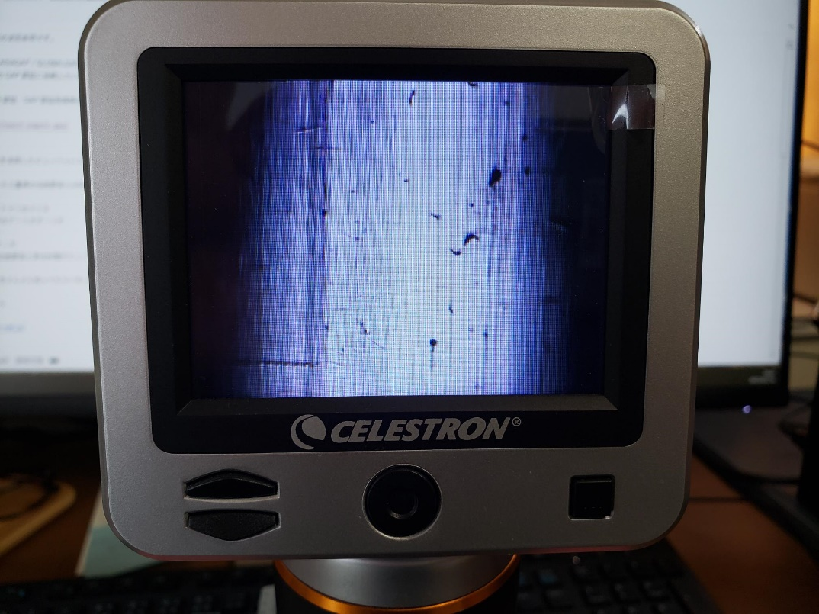
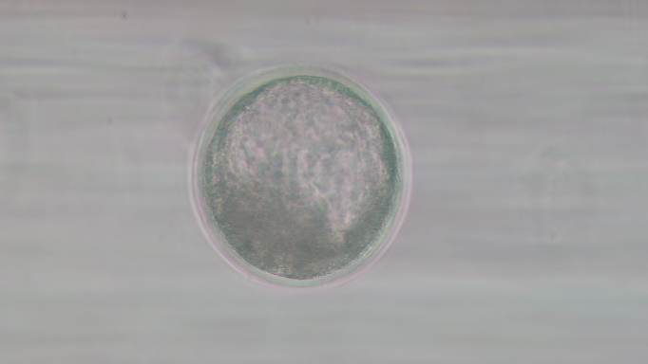
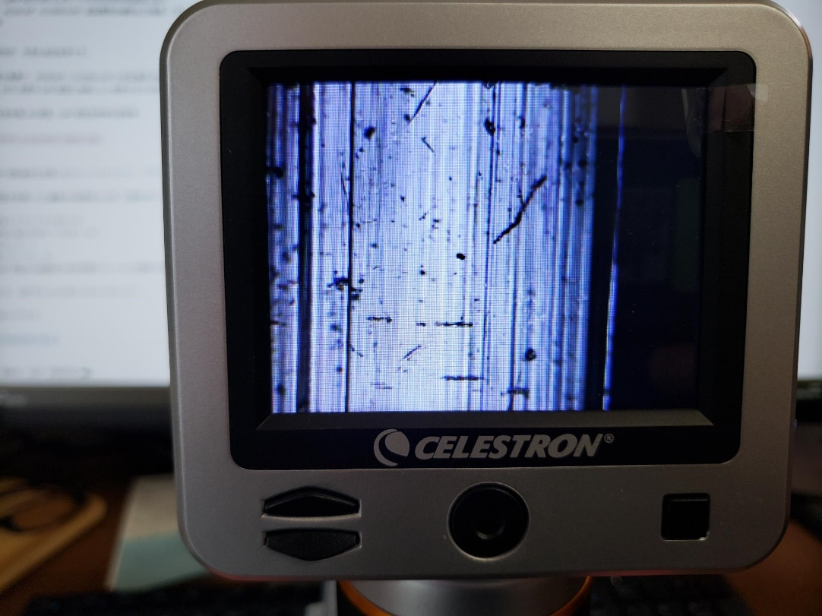
《Comparison of microscope images
of surface between G-PET straws》
Emvisible straw® & iStraw®
View of bovine in-vitro produced blastocyst
through a wall of Emvisible straw
G-PET straw supplied by other manufacturer

Slide 17
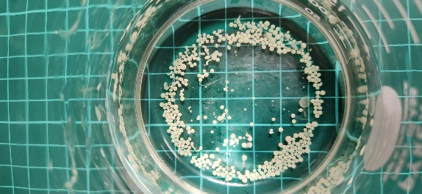
iSeed can change your existing stocked straws to
self-seeding straws！
Droplet for self-ice formation
View of Ice germination from iSeed in immersed in
distilled water at -4.0℃ using low-temperature
microscope. The temperature increased to -2.8 ℃ by
the latent heat.
iSeed in 110mn CaCl₂
solution

Slide 18
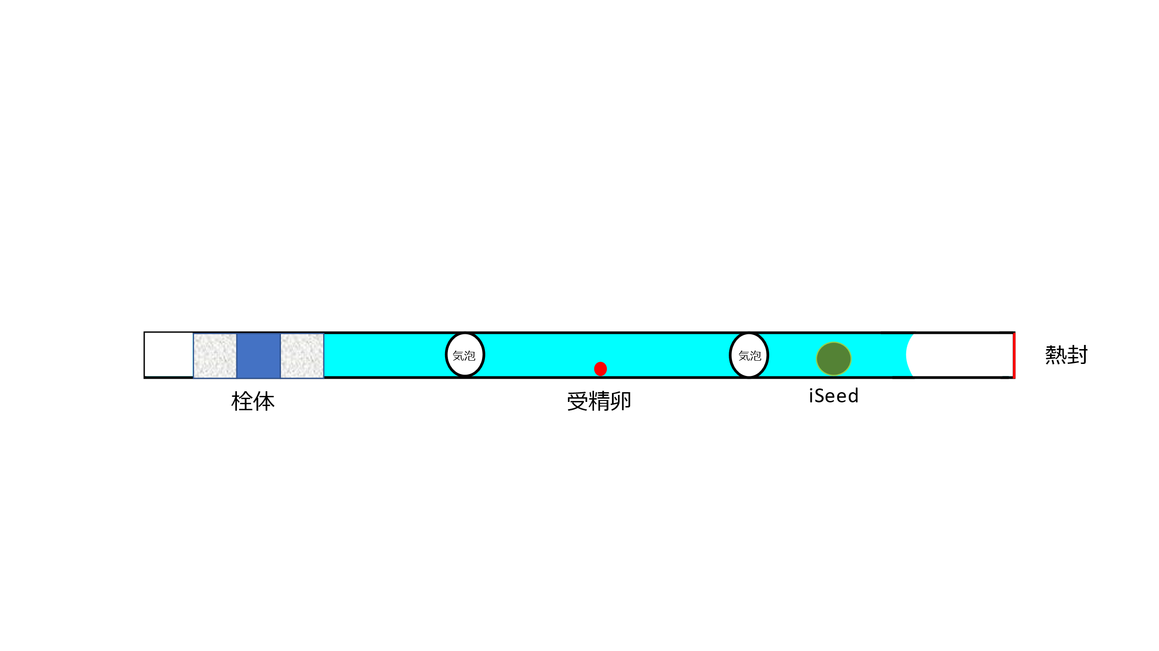
iSeed can change your existing stocked straws
to self-seeding straws ！
iSeed
The manner of aspiration of iSeed with embryo
heat
sealed
cotton plugs
embryo
Papers associated with iSeed:
・T. Kojima, T. Soma and N. Oguri. Effect of silver iodide as an ice inducer on viability of frozen-thawed rabbit morulae. Theriogenology 26(3):341-352 (1986).
・Toshiyuki Kojima, Tadashi Soma and Norihiko Oguri. Application of ice induction method using silver iodide to cryopreservation of bovine embryos. Jpn J Anim Reprod 33(2):73-76 (1987) in Japanese with English Summary.
・T. Kojima, T. Soma and N. Oguri. Effect of ice nucleation by droplet of immobilized silver iodide on freezing of rabbit and bovine embryos. Theriogenology 30(6):1199-1207 (1988).
・Toshiyuki Kojima. Studies on Cryopreservation of Mammalian Embryos
-Induction of Ice Formation with Droplets of Silver Iodide Immobilized in Alginate Gel-
SATO AWARD LECTURE FOR 1991 Jpn J Anim Reprod 37(5):13P-24p (1991) in Japanese with English Summary.
・Y. Fujino, Y. Ujisato, K. Endo, T. Tomizuka, T. Kojima and N. Oguri. Cryoprotective effect of egg yolk in cryopreservation of porcine embryos. Cryobiology 30:299-305 (1993).

Slide 19
【Topic!】
iSeed was applied for freezing of bovine spermatozoa in Cornell University.
J Dairy Sci 1993 Apr;76(4):1028-34.
Survival of bull spermatozoa seeded and frozen at different rates in egg yolk-tris and whole milk extenders
Y Chen ¹, R H Foote, C Tobback, L Zhang, S Hough
¹Department of Animal Science, Cornell University, Ithaca, NY 14853-4801
PMID: 8486834
DOI: 10.3168/jds.S0022-0302(93)77430-5
Abstract
Six factorially arranged experiments were designed to study effects of seeding, freezing, and thawing rates in whole milk and egg yolk-Tris extenders commonly used for commercial cryopreservation of bull sperm. In these extenders, semen normally is supercooled to -13 or -14 degrees C unless the sperm are seeded. When sperm were supercooled or seeded, either mechanically or with immobilized silver iodide, and frozen to -196 degrees C, the postthaw percentages of motile sperm were 59, 57, and 64%, respectively. Freezing rates of -15, -25, and -35 degrees C/min gave similar sperm survival rates and were superior to -5 degrees C/min. For milk, the critical freezing temperature extended to -75 degrees C before transfer to liquid nitrogen gave good results. For egg yolk-Tris extender, transfer to liquid nitrogen was less critical once -50 degrees C had been attained. Thawing of sperm in water baths at 25 and 45 degrees C gave similar results, and both temperatures were superior to 5 degrees C. The postthaw percentage of motile sperm in egg yolk-Tris was equal or superior to that of sperm frozen in milk. A freezing rate of -15 degrees C/min to -100 degrees C and thawing at 25 degrees C consistently gave good results.
References
Two scientific papers written by Kojima T. et al. , the papers of Jpn. J. Anim. Reprod (1988) and Theriogenology (1988) were cited by this paper.
Please see in page 20.

Slide 20
Order Placement：
・Name of Company/Firm/Office
・Name of Person/Position
・Address (including postal code)
・E-mail address
・Telephone Number mobile/fixed line
・The name of products required
・Total number and packaging
For example: one hundred pieces of 1, two hundreds pieces of 3 and five hundreds pieces of 5, in total 3,200 iStraw.
Contact us :
info@animoscience.co.jp
https://animoscience.co.jp “Inquiry”
＊We send the ordered products after confirming your payment to the following our bank account of AnimoScience Ltd.
The Musashino Bank, Ltd.
(bank code:0133 MUBKJPJT)
Katayanagi Branch (085)
Savings account
Account No. 1050147

